Slide 1
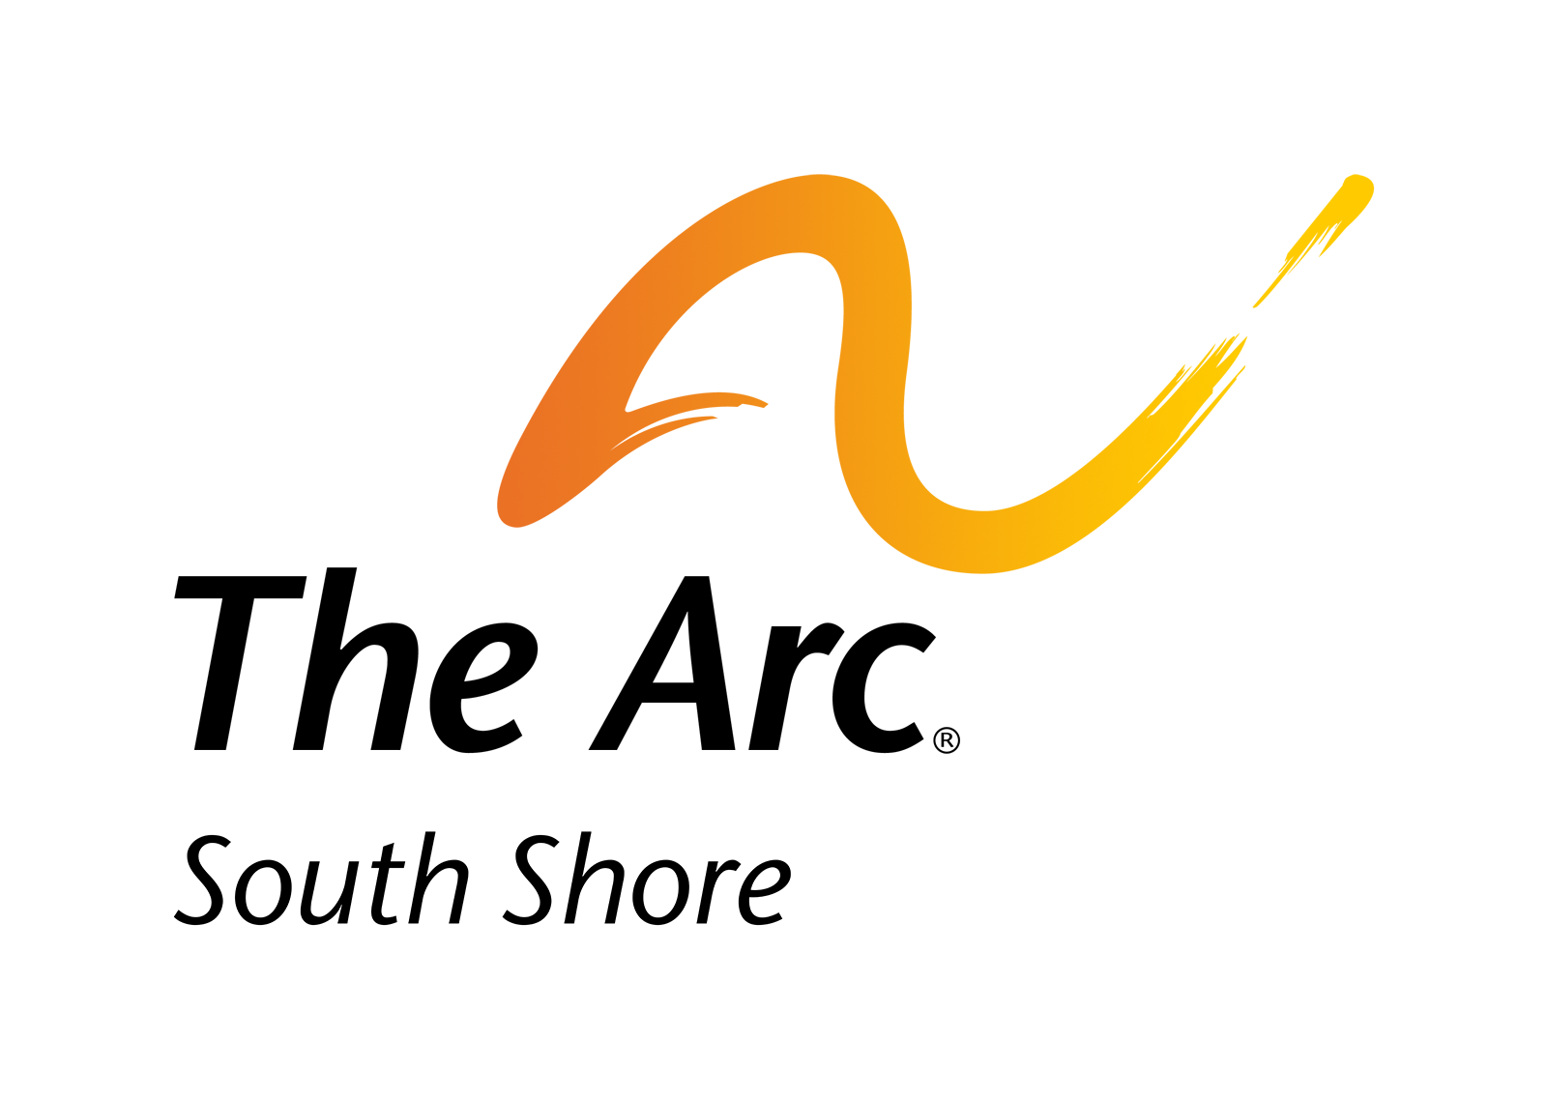
Strategic Plan 2026–2031

Slide 2
Our Mission & Vision
Mission Statement
The Arc of the South Shore supports people of all ages and disabilities in living full, independent lives. We do this by offering personalized, person-centered services, promoting inclusion in the community and advocating for their right to live their best lives.
Vision Statement
The Arc of the South Shore is deeply rooted in our community. We envision a future where every person with a disability and their family has the support, inclusion, and opportunities they need to live full and meaningful lives. As we celebrate 75 years, we will continue to offer and explore a wide range of services across all ages and disabilities. We will build on our leadership, experience, innovation and advocacy to keep improving and expanding our services.
Person Centered | Community | Transparency | Self-Determination | Diversity | Respect

Slide 3
Plan Overview and Intent
The Strategic Plan serves as a living roadmap that connects our mission, vision, and values to tangible action. Through shared accountability and collaboration, we will move The Arc forward together.
This five-year plan establishes an overarching framework that can evolve with external changes such as funding or federal policy shifts. It balances stability with flexibility.
By 2031, The Arc will be more connected, technologically capable, financially resilient, and deeply engaged with our community, an employer and provider of choice.

Slide 4
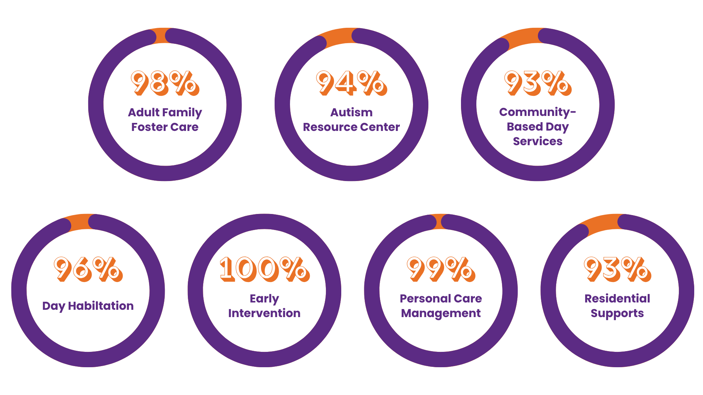
Satisfaction Survey Results
by Program

Slide 5
What do our Stakeholders want?
INDIVIDUALS
More accessible equipment
More community outings
More job or volunteer opportunities
Help with finding staff
More social opportunities
More skill building classes
FAMILY AND GUARDIANS
Keep great staff
Increase types of services and supports
Offer more support to parents and caregivers especially during BIG life changes
More community activities
Increase advocacy opportunities
Find new partnerships for funding
More education and training programs for EI parents

Slide 6
What do our Stakeholders want?
STAFF
Increase staff training and retention
Improve benefits
Improve technology
Professional Development
More opportunities to interact with staff from other programs
COMMUNITY SUPPORTERS
Increase staff training and retention
Expand services
Increase community engagement
Develop new partnerships
Provide more support groups for families
Provide more advocacy information and opportunities

Slide 7
What are we doing well?
Communication
Providing support to staff and families
Celebrate
Accomplishments
Workplace Culture
Help to make connections
Inclusiveness
Commitment to the mission
Relationship building

Slide 8
Where are there opportunities for growth?
Modernization and technology
Staff retention
More offerings for Adults with ID/D
Community visibility and engagement
Support groups
Fundraising
Education and training for parents
Professional development

Slide 9
Strategic Goals Overview
Goal 1
Strengthen AND SUPPORT OUR Workforce
Goal 2
IMPROVE AND CONNECT OUR technology
Goal 3
KEEP OUR FINANCES STRONG
Goal 4
IMPROVE AND DELIVER HIGH-QUALITY SERVICES
Goal 5
STRENGTHEN OUR PERSON-CENTERED APPROACH
Goal 6
DEEPEN COMMUNITY ENGAGEMENT AND PARTNERSHIPS

Slide 10

Goal #1: Strengthen and Support Our Workforce
Objective: By 2031, our team will be skilled, diverse, and committed to our mission. We will see this through better staff retention, more professional growth, and higher staff satisfaction.
Priority Actions:
Recruitment: Bring in qualified and diverse candidates who care about helping people with disabilities.
Retention: Create a positive and supportive workplace with fair pay, recognition, and chances to grow.
Professional Development: Offer training, mentorship, and clear paths for career advancement.
Workforce Well-being: Promote staff health, happiness, and engagement through supportive policies and practices.
Leadership Development: Train and support future leaders to keep our organization strong and innovative.
Success Indicators:
Hiring efforts consistently bring in new candidates
Staff turnover decreases each year
Positive feedback from staff, families, and the people we serve
More opportunities for professional development and higher participation

Slide 11

Goal #2: Improve and Connect Our Technology
Objective: By 2031, The Arc will utilize technology to make work easier, improve communication, and give staff better access to information. This will help staff provide the best support and services possible.
Priority Actions:
Electronic Health Record (EHR) – Put in place a new EHR system to make documentation, reporting, and care coordination faster and more organized.
Microsoft Tools: Use Microsoft programs (Outlook, Teams, SharePoint, OneDrive) in the same way across the organization to help everyone work together smoothly.
Knowledge Sharing: Create a central online hub (in Teams or SharePoint) where all staff can easily find policies, procedures, and resources.
Cloud Migration: Move systems to the cloud to make them safer, more reliable, and easier to access from anywhere.
Staff Training & Support: Offer regular training and tech support so staff feel confident using new tools.
Success Indicators:
EHR system is fully in use by all relevant staff
90% of staff feel confident and happy using technology
Staff spend less time on paperwork and documentation
Services are delivered more efficiently, with better teamwork and communication

Slide 12

Goal #3: Keep Our Finances Strong
Objective: By 2031, The Arc of the South Shore will be financially stable and strong. This will allow us to keep offering high-quality services and invest in new opportunities for growth.
Priority Actions:
Diverse Funding – Sustain and expand funding from a variety of sources, including state contracts, private pay, and partnerships.
Fundraising & Development – Build strong relationships with donors and organize fundraising events to gain more community support.
Community Partnerships & Giving – Work closely with community members and organizations to increase donations, sponsorships, and teamwork that support our mission.
Grants – Find and apply for grants that match our mission and long-term goals.
Financial Responsibility – Maintain good financial practices, transparent reporting, and effective management of resources.
Innovation & Growth – Invest in new programs and services that help our mission and increase revenue.
Success Indicators:
Strong financial health and savings
Positive cash flow each year
Growth in different types of funding
Successful grant awards for key projects
More community donations, sponsorships, and partnerships
Clear results from investments in new programs and services

Slide 13

Goal #4: Improve and Deliver High-Quality Services
Objective: By 2031, The Arc of the South Shore will provide high-quality services that match our strategic goals. We will measure our progress, make continuous improvements, and ensure our work meets high standards.
Priority Actions:
Performance Metrics – Create and track key performance indicators (KPIs) to measure progress toward each goal.
Quality Standards and Compliance– Strengthen policies, procedures, and monitoring systems to make sure all programs meet high standards and follow all licensing and certification rules.
Continuous Improvement – Use data, feedback, and proven best practices to keep improving our programs and services.
Staff Engagement – Involve staff at every level in improving quality and tracking performance.
Accountability & Transparency – Share updates and progress with the community and stakeholders to build trust and show results.
Success Indicators:
Key Performance Indicators for all goals are tracked and reported each year
Measurable improvements in service quality shown through feedback, data, and audits
Staff participation in improvement projects meets or exceeds targets
Annual reports show that programs align with our goals and produce positive results

Slide 14

Goal #5: Strengthen Our Person-Centered Approach
Objective: By 2031, every person we support will receive services that focus on their individual goals and choices. Our goal is to help each person live a meaningful, independent life and feel fully included in their community.
Priority Actions:
Individualized Supports – Make sure services match each person’s unique goals, preferences, and needs.
Voice and Choice – Encourage individuals and families to take an active role in planning and making decisions about their supports.
Staff Training – Offer ongoing training so staff understand and use person-centered practices in their daily work.
Feedback and Outcomes – Collect feedback from individuals and families to measure satisfaction and guide improvements.
Community Engagement – Build strong connections between the people we support and the wider community through education, partnerships, and shared advocacy.
Inclusion & Advocacy – Create opportunities that promote belonging, independence, and full participation in community life.
Success Indicators:
High satisfaction scores from individuals and families
All staff trained in person-centered practices and positive behavioral supports
Policies and procedures reflect person-centered values
More opportunities for individuals to engage and be included in their communities

Slide 15

Goal #6: Deepen Community Engagement and Partnerships
Objective: By 2031, strengthen connections with individuals, families, community partners, and the public to build greater awareness, teamwork, and support for The Arc’s mission.
Priority Actions:
Outreach and Awareness – Share The Arc’s story and impact through events, personal stories, and media to increase visibility in the community.
Partnerships – Build and maintain strong relationships with schools, employers, healthcare providers, and other community organizations.
Advocacy Engagement – Encourage community members to take part in advocacy efforts that support inclusion and fairness for all.
Volunteerism – Offer more ways for volunteers to get involved by sharing their time, skills, and talents.
Family and Participant Connection – Create more chances for families and individuals to connect, learn from each other, and build community.
Community Giving – Encourage local donations and sponsorships that support inclusion and belonging.
Success Indicators:
More active community partnerships and joint projects
Growth in volunteer participation each year
Higher public awareness and community involvement
Increase in local giving and sponsorships
Positive feedback from individuals, families, and partners about engagement efforts

